Slide 1


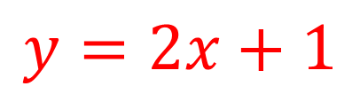
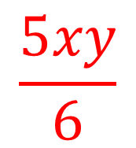
My Algebra
Interactive Notebook
$$\frac{5xy}{6}$$
$$3ab$$
$$2x+3y$$
$$y=2x+1$$
Name
Class
Term 3 Semester 2

Slide 2
Contents
Page
Date
Description
2
3

Slide 3
Tasks
24
7
30
Essential Question
Questions
Notes
Summary
8
9

Slide 4
24
7
30
Date
Solving Equations
EQ – How are inverse operations used to solve equations?
7

Slide 5
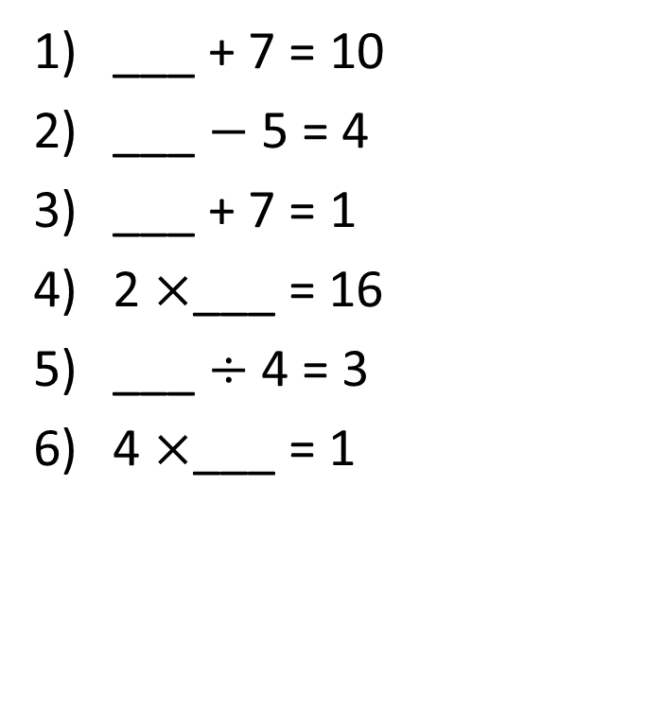
Task – Find the missing numbers
___ + 7 = 10
___ $−$5 = 4
___ + 7 = 1
2 $×$___ = 16
___ $÷$ 4 = 3
4 $×$___ = 1

Slide 6
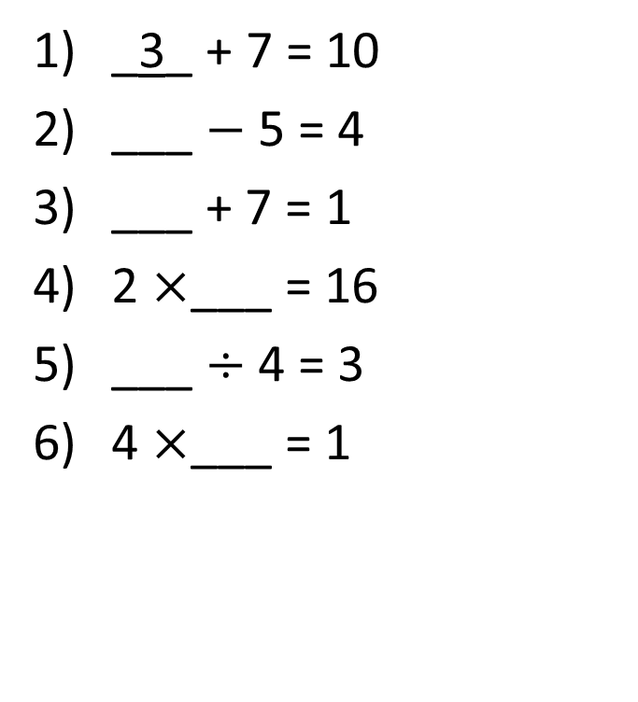
Task – Find the missing numbers
_3_ + 7 = 10
___ $−$5 = 4
___ + 7 = 1
2 $×$___ = 16
___ $÷$ 4 = 3
4 $×$___ = 1

Slide 7
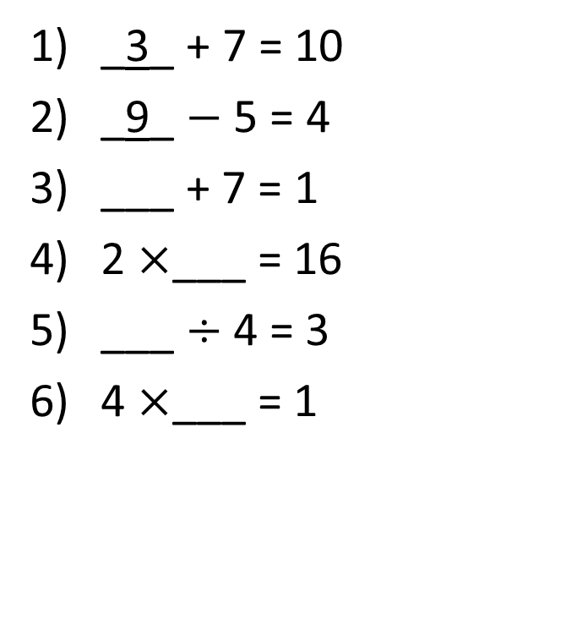
Task – Find the missing numbers
_3_ + 7 = 10
_9_ $−$5 = 4
___ + 7 = 1
2 $×$___ = 16
___ $÷$ 4 = 3
4 $×$___ = 1

Slide 8
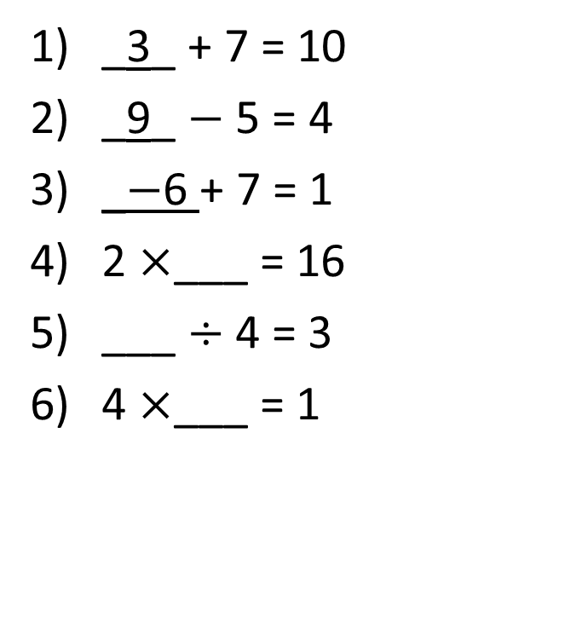
Task – Find the missing numbers
_3_ + 7 = 10
_9_ $−$5 = 4
_$−$6 + 7 = 1
2 $×$___ = 16
___ $÷$ 4 = 3
4 $×$___ = 1

Slide 9
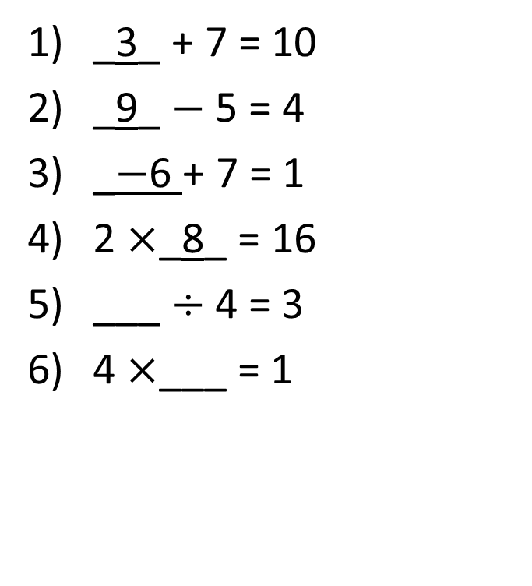
Task – Find the missing numbers
_3_ + 7 = 10
_9_ $−$5 = 4
_$−$6 + 7 = 1
2 $×$_8_ = 16
___ $÷$ 4 = 3
4 $×$___ = 1

Slide 10
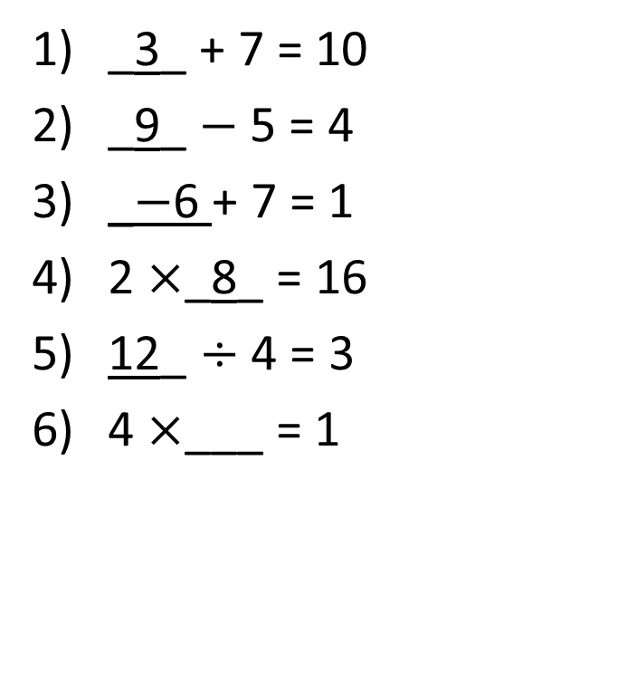
Task – Find the missing numbers
_3_ + 7 = 10
_9_ $−$5 = 4
_$−$6 + 7 = 1
2 $×$_8_ = 16
12_ $÷$ 4 = 3
4 $×$___ = 1
In pairs choose A and B.

Slide 11
Task – Find the missing numbers
_3_ + 7 = 10
_9_ $−$5 = 4
_$−$6 + 7 = 1
2 $×$_8_ = 16
12_ $÷$ 4 = 3
4 $×$___ = 1
In pairs choose A and B.
Each choose one of the questions.

Slide 12
Task – Find the missing numbers
_3_ + 7 = 10
_9_ $−$5 = 4
_$−$6 + 7 = 1
2 $×$_8_ = 16
12_ $÷$ 4 = 3
4 $×$___ = 1
In pairs choose A and B.
Each choose one of the questions. Person B explain to your partner how you worked this out

Slide 13
Task – Find the missing numbers
_3_ + 7 = 10
_9_ $−$5 = 4
_$−$6 + 7 = 1
2 $×$_8_ = 16
12_ $÷$ 4 = 3
4 $×$___ = 1
In pairs choose A and B.
Each choose one of the questions. Person B explain to your partner how you worked this out.
Now person A.

Slide 14
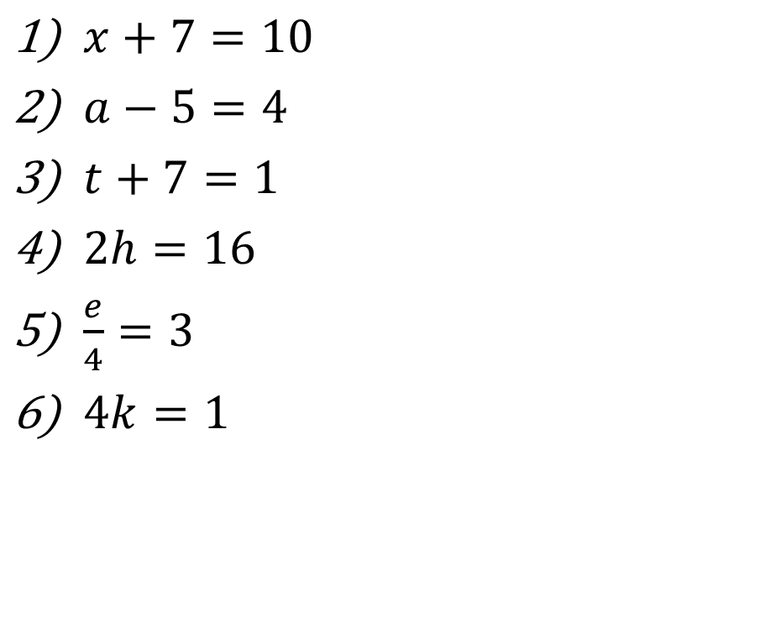
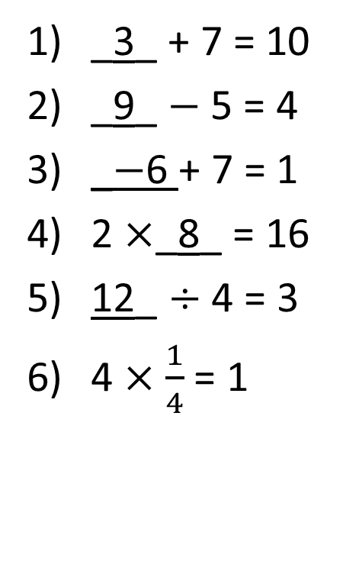
Task – Find the missing numbers
_3_ + 7 = 10
_9_ $−$5 = 4
_$−$6 + 7 = 1
2 $×$_8_ = 16
12_ $÷$ 4 = 3
4 $×\frac{1}{4}$ = 1
$x+7=10$
$a−5=4$
$t+7=1$
$2h=16$
$\frac{e}{4}=3$
$4k=1$

Slide 15
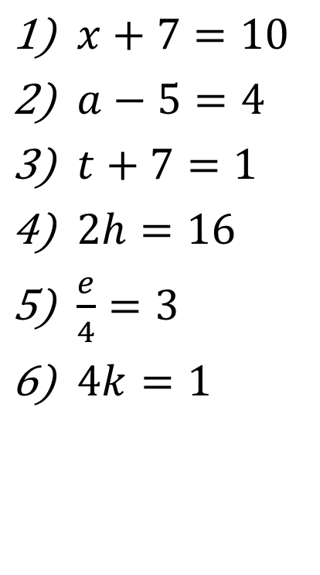
Task – Find the missing numbers
$x+7=10$
$a−5=4$
$t+7=1$
$2h=16$
$\frac{e}{4}=3$
$4k=1$

Slide 16
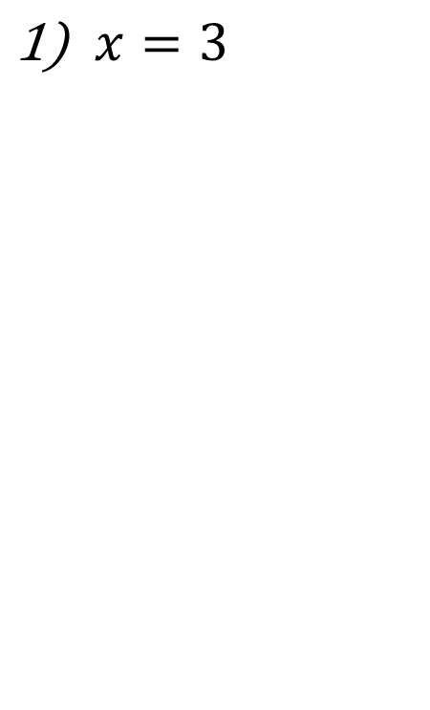
Task – Find the missing numbers
$x+7=10$
$a−5=4$
$t+7=1$
$2h=16$
$\frac{e}{4}=3$
$4k=1$
$x=3$

Slide 17
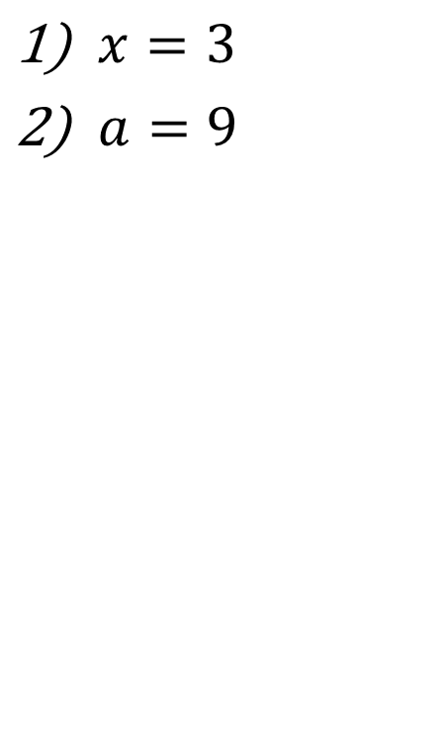
Task – Find the missing numbers
$x+7=10$
$a−5=4$
$t+7=1$
$2h=16$
$\frac{e}{4}=3$
$4k=1$
$x=3$
$a=9$

Slide 18
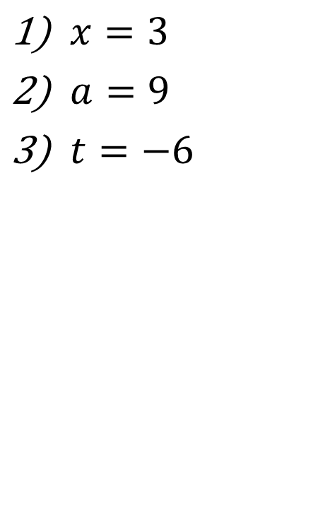
Task – Find the missing numbers
$x+7=10$
$a−5=4$
$t+7=1$
$2h=16$
$\frac{e}{4}=3$
$4k=1$
$x=3$
$a=9$
$t=−6$

Slide 19
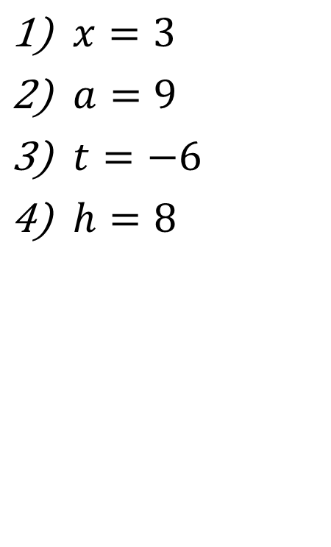
Task – Find the missing numbers
$x+7=10$
$a−5=4$
$t+7=1$
$2h=16$
$\frac{e}{4}=3$
$4k=1$
$x=3$
$a=9$
$t=−6$
$h=8$

Slide 20
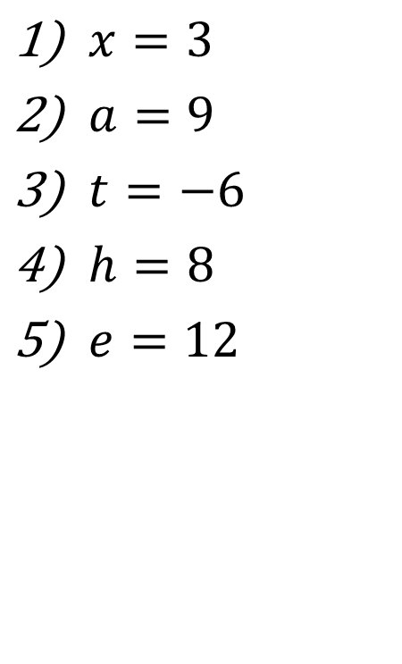
Task – Find the missing numbers
$x+7=10$
$a−5=4$
$t+7=1$
$2h=16$
$\frac{e}{4}=3$
$4k=1$
$x=3$
$a=9$
$t=−6$
$h=8$
$e=12$

Slide 21
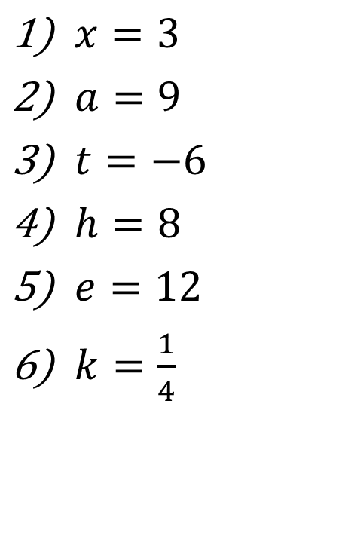
Task – Find the missing numbers
$x+7=10$
$a−5=4$
$t+7=1$
$2h=16$
$\frac{e}{4}=3$
$4k=1$
$x=3$
$a=9$
$t=−6$
$h=8$
$e=12$
$k=\frac{1}{4}$

Slide 22
24
7
30
Date
Solving Equations
EQ – How are inverse operations used to solve equations?
An equation is mathematical statement that has two expressions equal
7

Slide 23
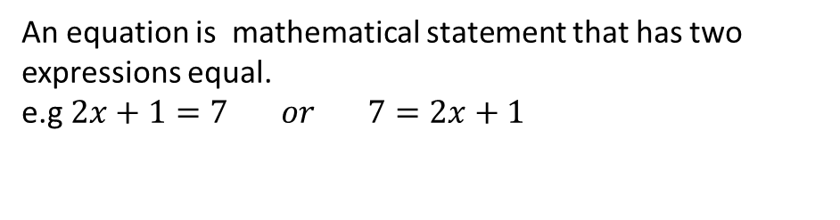
24
7
30
Date
Solving Equations
EQ – How are inverse operations used to solve equations?
An equation is mathematical statement that has two expressions equal.
e.g $2x+1=7 or 7=2x+1$
7

Slide 24
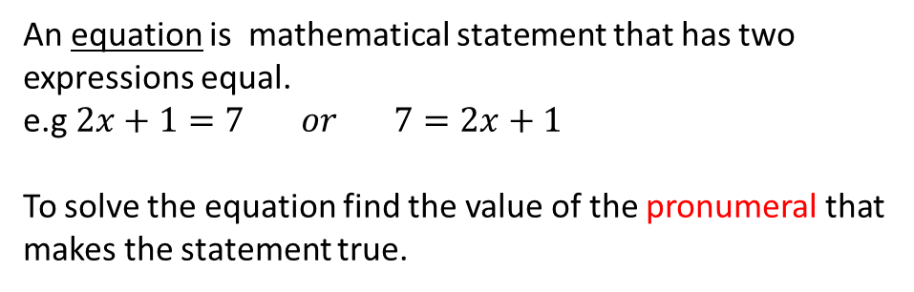
24
7
30
Date
Solving Equations
EQ – How are inverse operations used to solve equations?
An equation is mathematical statement that has two expressions equal.
e.g $2x+1=7 or 7=2x+1$
To solve the equation find the value of the pronumeral that makes the statement true.
the letter
7

Slide 25
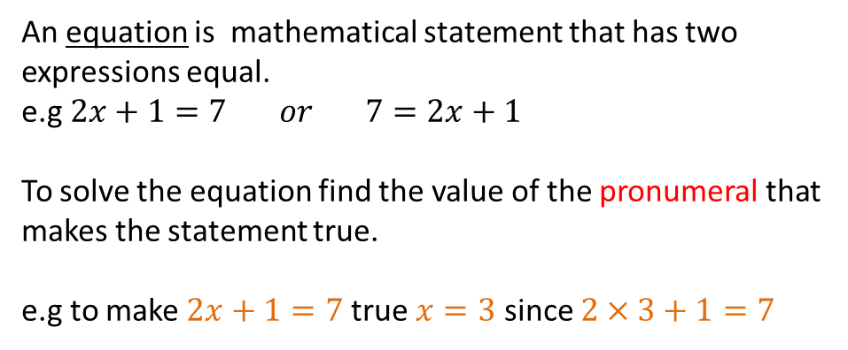
24
7
30
Date
Solving Equations
EQ – How are inverse operations used to solve equations?
An equation is mathematical statement that has two expressions equal.
e.g $2x+1=7 or 7=2x+1$
To solve the equation find the value of the pronumeral that makes the statement true.
e.g to make $2x+1=7$true $x=3$ since $2×3+1=7$
the letter
7

Slide 26
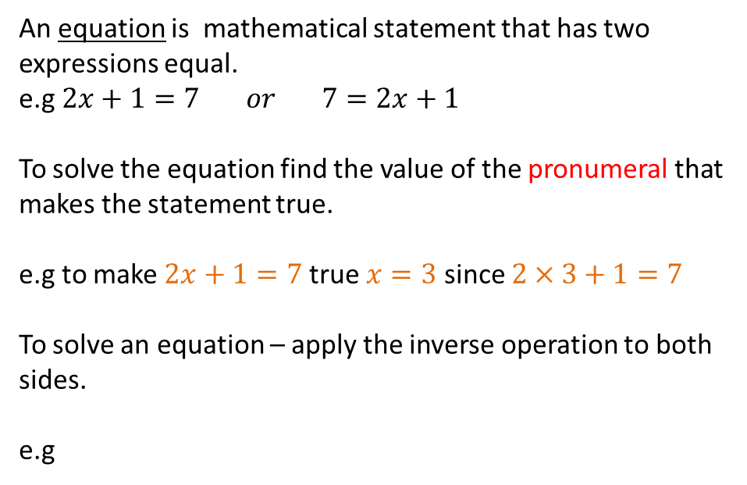
24
7
30
Date
Solving Equations
EQ – How are inverse operations used to solve equations?
An equation is mathematical statement that has two expressions equal.
e.g $2x+1=7 or 7=2x+1$
To solve the equation find the value of the pronumeral that makes the statement true.
e.g to make $2x+1=7$true $x=3$ since $2×3+1=7$
To solve an equation – apply the inverse operation to both sides.
e.g
the letter
7

Slide 27
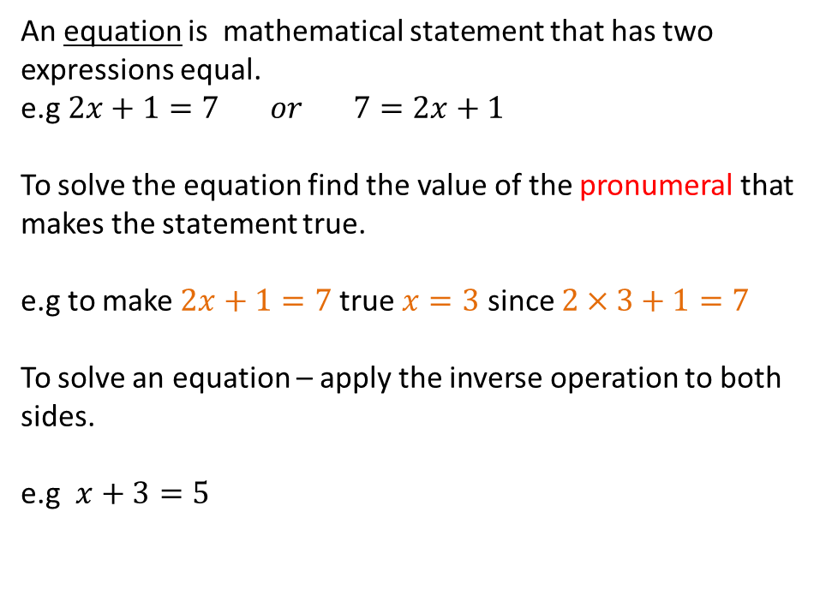
24
7
30
Date
Solving Equations
EQ – How are inverse operations used to solve equations?
An equation is mathematical statement that has two expressions equal.
e.g $2x+1=7 or 7=2x+1$
To solve the equation find the value of the pronumeral that makes the statement true.
e.g to make $2x+1=7$true $x=3$ since $2×3+1=7$
To solve an equation – apply the inverse operation to both sides.
e.g $x+3=5$
the letter
7

Slide 28
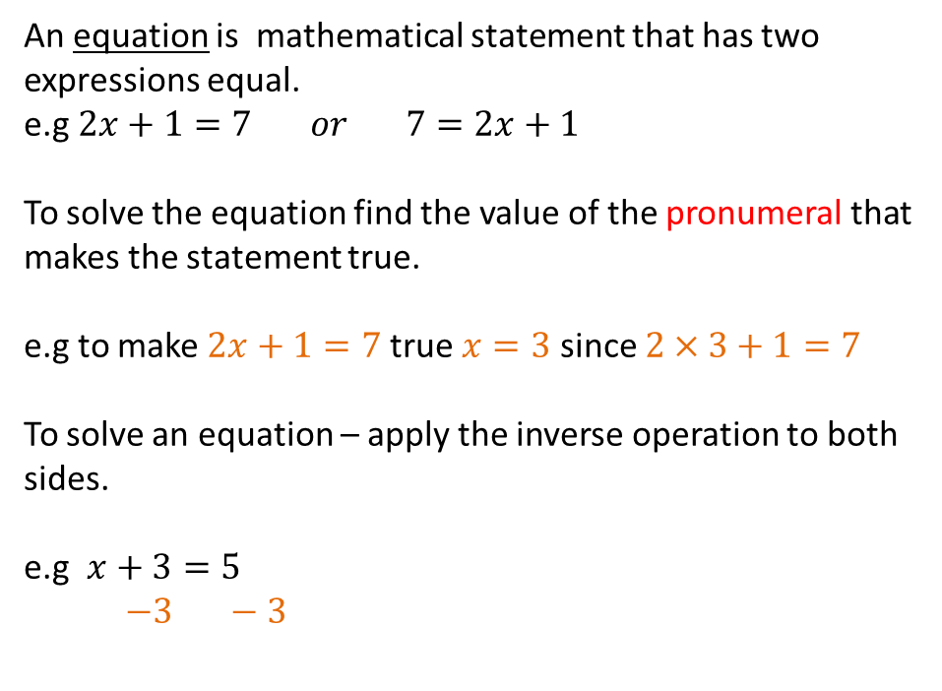
24
7
30
Date
Solving Equations
EQ – How are inverse operations used to solve equations?
An equation is mathematical statement that has two expressions equal.
e.g $2x+1=7 or 7=2x+1$
To solve the equation find the value of the pronumeral that makes the statement true.
e.g to make $2x+1=7$true $x=3$ since $2×3+1=7$
To solve an equation – apply the inverse operation to both sides.
e.g $x+3=5$
$−3 −3$
the letter
7

Slide 29

24
7
30
Date
Solving Equations
EQ – How are inverse operations used to solve equations?
An equation is mathematical statement that has two expressions equal.
e.g $2x+1=7 or 7=2x+1$
To solve the equation find the value of the pronumeral that makes the statement true.
e.g to make $2x+1=7$true $x=3$ since $2×3+1=7$
To solve an equation – apply the inverse operation to both sides.
e.g $x+3=5$
$−3 −3$
$x=2$
the letter
7

Slide 30

24
7
30
Date
Solving Equations
EQ – How are inverse operations used to solve equations?
An equation is mathematical statement that has two expressions equal.
e.g $2x+1=7 or 7=2x+1$
To solve the equation find the value of the pronumeral that makes the statement true.
e.g to make $2x+1=7$true $x=3$ since $2×3+1=7$
To solve an equation – apply the inverse operation to both sides.
e.g $x+3=5$ $p−8=5$
$−3 −3$
$x=2$
the letter
7

Slide 31
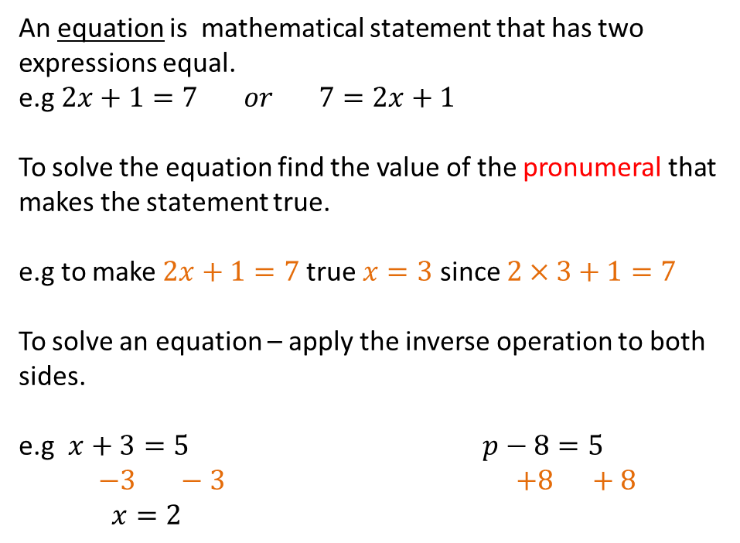
24
7
30
Date
Solving Equations
EQ – How are inverse operations used to solve equations?
An equation is mathematical statement that has two expressions equal.
e.g $2x+1=7 or 7=2x+1$
To solve the equation find the value of the pronumeral that makes the statement true.
e.g to make $2x+1=7$true $x=3$ since $2×3+1=7$
To solve an equation – apply the inverse operation to both sides.
e.g $x+3=5$ $p−8=5$
$−3 −3$ $+8 +8$
$x=2$
the letter
7

Slide 32
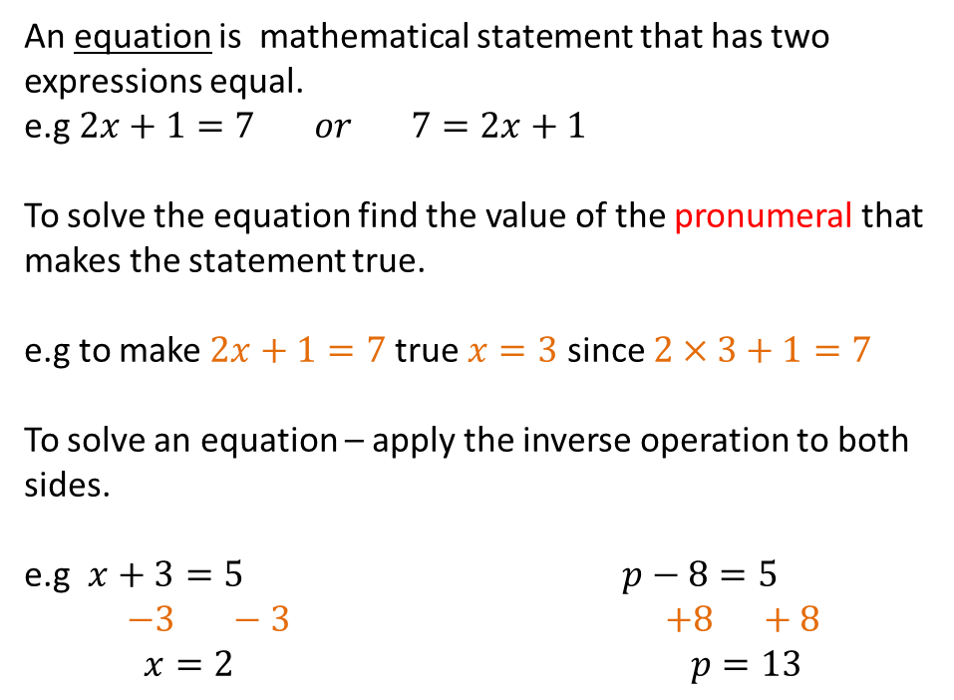
24
7
30
Date
Solving Equations
EQ – How are inverse operations used to solve equations?
An equation is mathematical statement that has two expressions equal.
e.g $2x+1=7 or 7=2x+1$
To solve the equation find the value of the pronumeral that makes the statement true.
e.g to make $2x+1=7$true $x=3$ since $2×3+1=7$
To solve an equation – apply the inverse operation to both sides.
e.g $x+3=5$ $p−8=5$
$−3 −3$ $+8 +8$
$x=2$ $p=13$
the letter
7

Slide 33
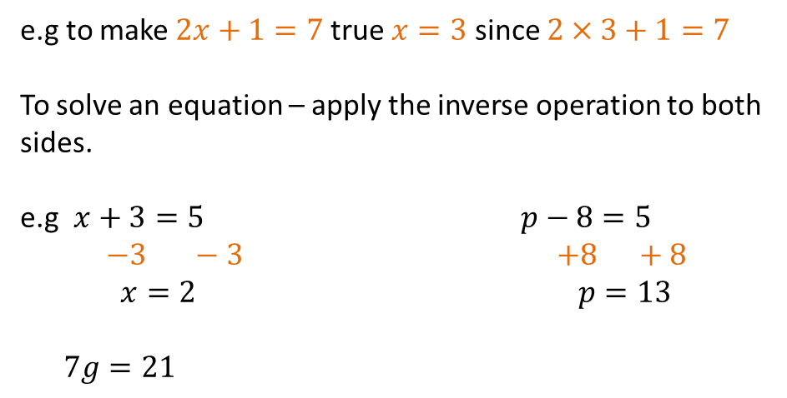
24
7
30
Date
Solving Equations
EQ – How are inverse operations used to solve equations?
e.g to make $2x+1=7$true $x=3$ since $2×3+1=7$
To solve an equation – apply the inverse operation to both sides.
e.g $x+3=5$ $p−8=5$
$−3 −3$ $+8 +8$
$x=2$ $p=13$
$7g=21$
the letter
7

Slide 34
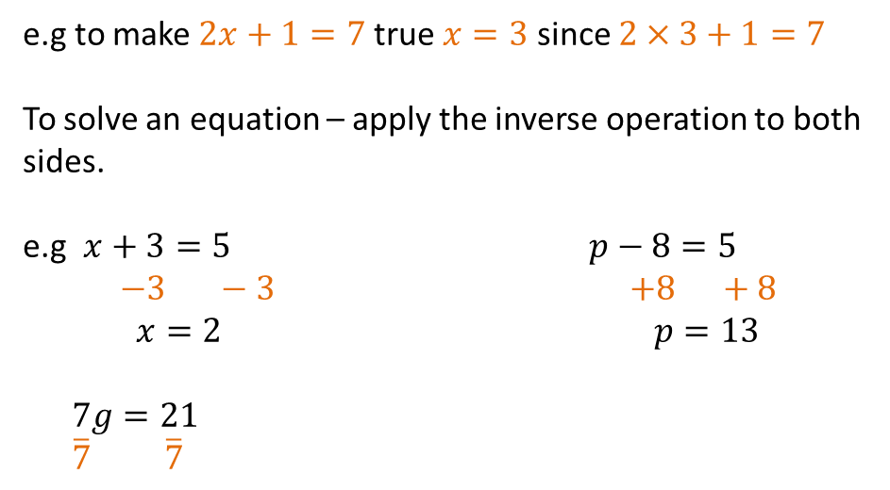
24
7
30
Date
Solving Equations
EQ – How are inverse operations used to solve equations?
e.g to make $2x+1=7$true $x=3$ since $2×3+1=7$
To solve an equation – apply the inverse operation to both sides.
e.g $x+3=5$ $p−8=5$
$−3 −3$ $+8 +8$
$x=2$ $p=13$
$7g=21$
$\overline{7}$ $\overline{7}$
the letter
7

Slide 35
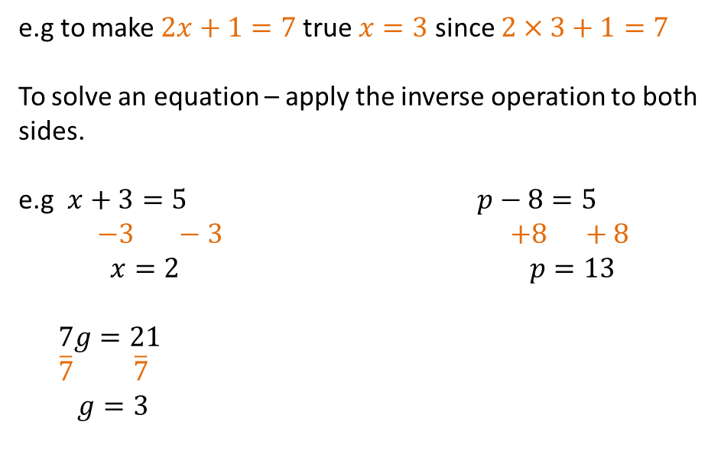
24
7
30
Date
Solving Equations
EQ – How are inverse operations used to solve equations?
e.g to make $2x+1=7$true $x=3$ since $2×3+1=7$
To solve an equation – apply the inverse operation to both sides.
e.g $x+3=5$ $p−8=5$
$−3 −3$ $+8 +8$
$x=2$ $p=13$
$7g=21$
$\overline{7}$ $\overline{7}$
$g=3$
the letter
7

Slide 36
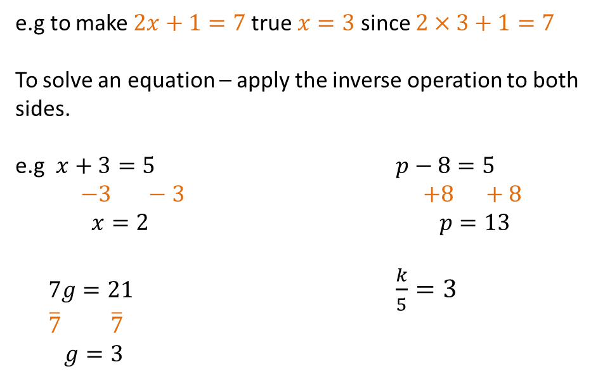
24
7
30
Date
Solving Equations
EQ – How are inverse operations used to solve equations?
e.g to make $2x+1=7$true $x=3$ since $2×3+1=7$
To solve an equation – apply the inverse operation to both sides.
e.g $x+3=5$ $p−8=5$
$−3 −3$ $+8 +8$
$x=2$ $p=13$
$7g=21$ $\frac{k}{5}=3$
$\overline{7}$ $\overline{7}$
$g=3$
the letter
7

Slide 37
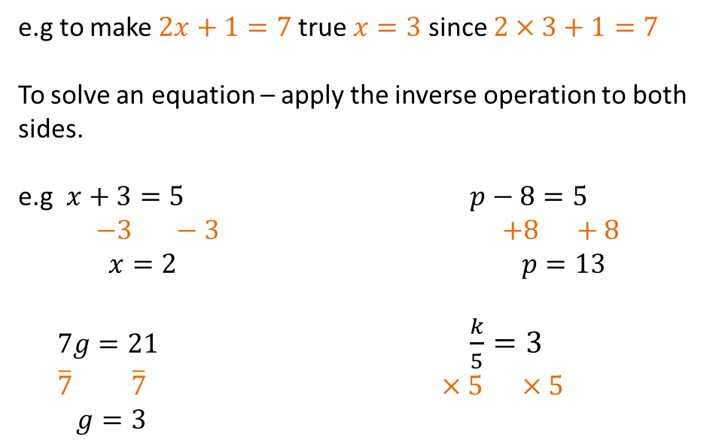
24
7
30
Date
Solving Equations
EQ – How are inverse operations used to solve equations?
e.g to make $2x+1=7$true $x=3$ since $2×3+1=7$
To solve an equation – apply the inverse operation to both sides.
e.g $x+3=5$ $p−8=5$
$−3 −3$ $+8 +8$
$x=2$ $p=13$
$7g=21$ $\frac{k}{5}=3$
$\overline{7}$ $\overline{7}$ $×5$ $×5$
$g=3$
the letter
7

Slide 38
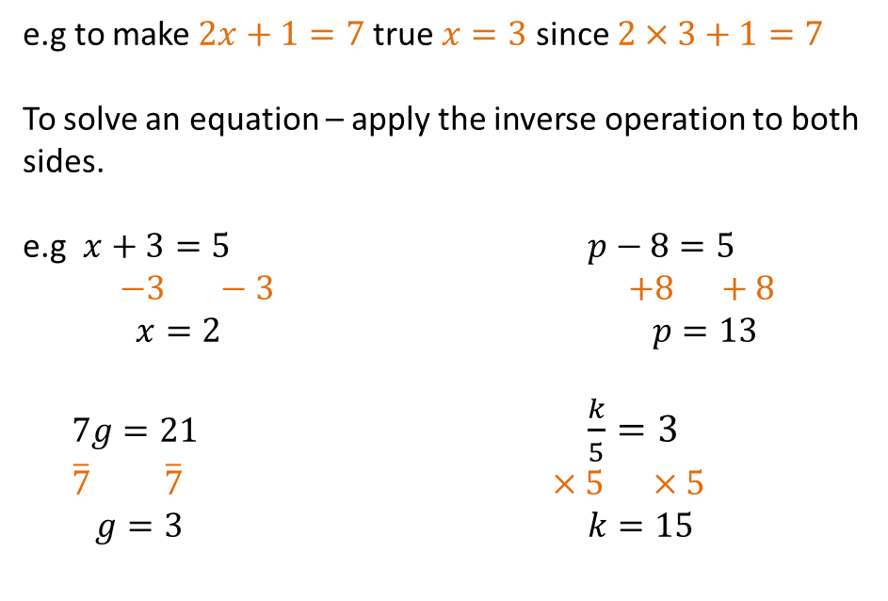
24
7
30
Date
Solving Equations
EQ – How are inverse operations used to solve equations?
e.g to make $2x+1=7$true $x=3$ since $2×3+1=7$
To solve an equation – apply the inverse operation to both sides.
e.g $x+3=5$ $p−8=5$
$−3 −3$ $+8 +8$
$x=2$ $p=13$
$7g=21$ $\frac{k}{5}=3$
$\overline{7}$ $\overline{7}$ $×5$ $×5$
$g=3$ $k=15$
the letter
7

Slide 39
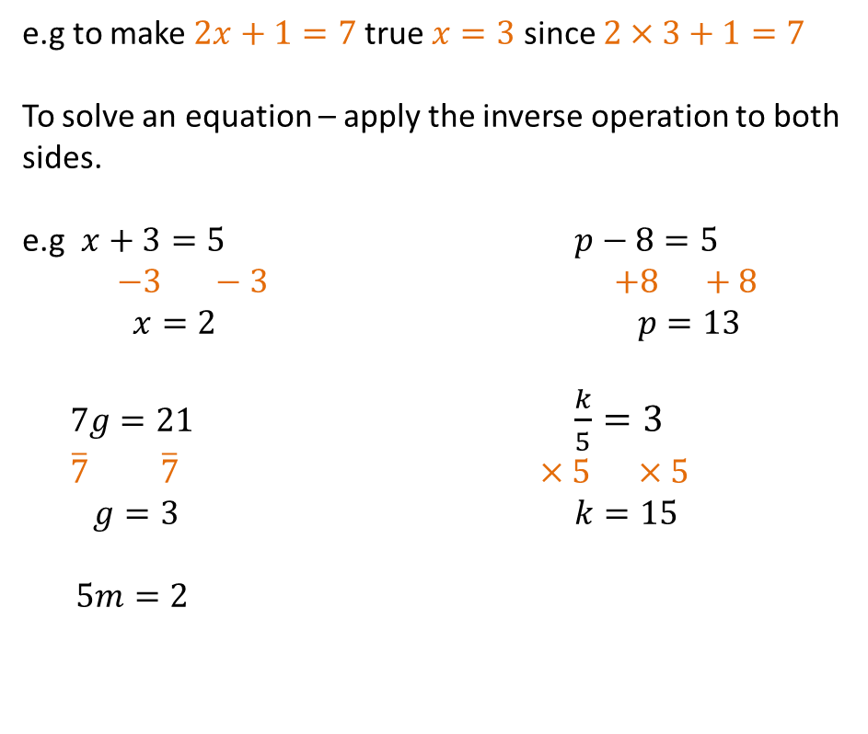
24
7
30
Date
Solving Equations
EQ – How are inverse operations used to solve equations?
e.g to make $2x+1=7$true $x=3$ since $2×3+1=7$
To solve an equation – apply the inverse operation to both sides.
e.g $x+3=5$ $p−8=5$
$−3 −3$ $+8 +8$
$x=2$ $p=13$
$7g=21$ $\frac{k}{5}=3$
$\overline{7}$ $\overline{7}$ $×5$ $×5$
$g=3$ $k=15$
$5m=2$
the letter
7

Slide 40
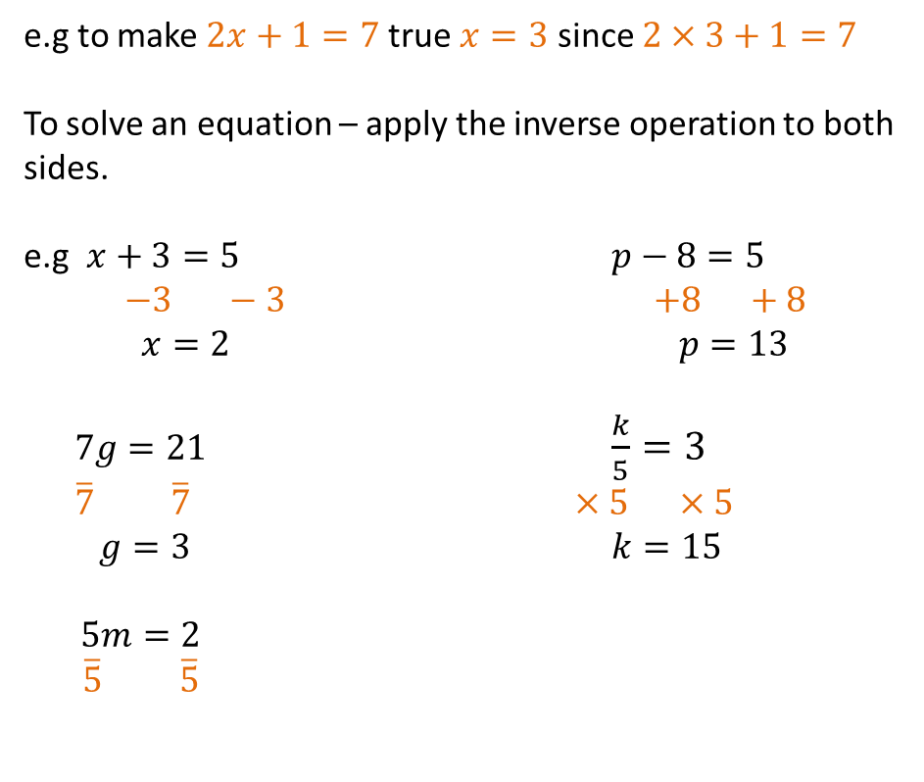
24
7
30
Date
Solving Equations
EQ – How are inverse operations used to solve equations?
e.g to make $2x+1=7$true $x=3$ since $2×3+1=7$
To solve an equation – apply the inverse operation to both sides.
e.g $x+3=5$ $p−8=5$
$−3 −3$ $+8 +8$
$x=2$ $p=13$
$7g=21$ $\frac{k}{5}=3$
$\overline{7}$ $\overline{7}$ $×5$ $×5$
$g=3$ $k=15$
$5m=2$
$\overline{5}$ $\overline{5}$
the letter
7

Slide 41

24
7
30
Date
Solving Equations
EQ – How are inverse operations used to solve equations?
e.g to make $2x+1=7$true $x=3$ since $2×3+1=7$
To solve an equation – apply the inverse operation to both sides.
e.g $x+3=5$ $p−8=5$
$−3 −3$ $+8 +8$
$x=2$ $p=13$
$7g=21$ $\frac{k}{5}=3$
$\overline{7}$ $\overline{7}$ $×5$ $×5$
$g=3$ $k=15$
$5m=2$
$\overline{5}$ $\overline{5}$
$m=\frac{2}{5}$
the letter
7

Slide 42
Fill in the questions

Slide 43
24
7
30
Date
Solving Equations
EQ – How are inverse operations used to solve equations?
What is an equation?
An equation is mathematical statement that has two expressions equal.
e.g $2x+1=7 or 7=2x+1$
To solve the equation find the value of the pronumeral that makes the statement true.
e.g to make $2x+1=7$true $x=3$ since $2×3+1=7$
To solve an equation – apply the inverse operation to both sides.
e.g $x+3=5$ $p−8=5$
$−3 −3$ $+8 +8$
$x=2$ $p=13$
the letter
7

Slide 44
24
7
30
Date
Solving Equations
EQ – How are inverse operations used to solve equations?
What is an equation?
An equation is mathematical statement that has two expressions equal.
e.g $2x+1=7 or 7=2x+1$
To solve the equation find the value of the pronumeral that makes the statement true.
e.g to make $2x+1=7$true $x=3$ since $2×3+1=7$
To solve an equation – apply the inverse operation to both sides.
e.g $x+3=5$ $p−8=5$
$−3 −3$ $+8 +8$
$x=2$ $p=13$
the letter
What does it mean to solve an equation?
7

Slide 45
24
7
30
Date
Solving Equations
EQ – How are inverse operations used to solve equations?
What is an equation?
An equation is mathematical statement that has two expressions equal.
e.g $2x+1=7 or 7=2x+1$
To solve the equation find the value of the pronumeral that makes the statement true.
e.g to make $2x+1=7$true $x=3$ since $2×3+1=7$
To solve an equation – apply the inverse operation to both sides.
e.g $x+3=5$ $p−8=5$
$−3 −3$ $+8 +8$
$x=2$ $p=13$
the letter
What does it mean to solve an equation?
How to solve equations?(One step)
7

Slide 46
24
7
30
Date
Solving Equations
EQ – How are inverse operations used to solve equations?
What is an equation?
An equation is mathematical statement that has two expressions equal.
e.g $2x+1=7 or 7=2x+1$
To solve the equation find the value of the pronumeral that makes the statement true.
e.g to make $2x+1=7$true $x=3$ since $2×3+1=7$
To solve an equation – apply the inverse operation to both sides.
e.g $x+3=5$ $p−8=5$
$−3 −3$ $+8 +8$
$x=2$ $p=13$
the letter
What does it mean to solve an equation?
How to solve equations?(One step)
Examples
7

Slide 47
Notes Review
24, 7 ,30
Date
Title
Essential question
Notes complete
Notes complete with colour and diagrams
Questions completed
Contents page filed in
Formula page filled in

Slide 48
Homework
Review your notes and write a summary answering the essential question.

